Slide 1
Digits Recognition
Stancu Gabriel – Iulian
30432

Slide 2
TABLE OF CONTENTS
01
02
03
INTRODUCTION
THEORETICAL BACKGROUND
DESIGN
Problem and desired achievements description
Context description, overall usage of the solution
Studied methods, possible solutions and desired approaches description

Slide 3
INTRODUCTION
Parameter displaying screens recording
Numerical parameters
MATCHING of the screen captures on digits (in – memory values)
Storing parameter values when physical context does not allow direct access to them
Electrical circuits, medical equipment measured values etc.

Slide 4
THEORETICAL BACKGROUND
Getting pictures of a screen that continuously displays parameter values: circuit measurements (voltages on certain branches etc.), medical equipment (pulse, temperature of patient etc.)
Recognize the digits in these screen pictures (usually in the same photo area => speedup), truncate / label them
Take each truncated / labeled digit, apply matching algorithms to determine the actual digit. Form numbers by grouping close digits
After successfully getting the numbers, store them (i.e. in a database) for further use

Slide 5
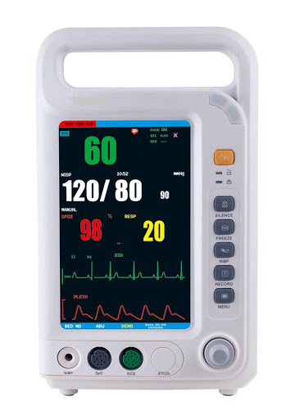

Slide 6
DESIGN ALTERNATIVES
 | DIFFICULTY | ACCURACY | DESCRIPTION
OpenCV KNN | HARD | HIGH | Train and test a model to recognize the digits
Projection | AVERAGE | AVERAGE | Project digits on the “ground”, compute best match against known patterns

Slide 7
COMPARING APPROACHES
OpenCV KNN
Projections
Process the images to extract contours of digits
Label the data
Train using the labeled data
For each contour in labeled data (test sample), get best digit match
Enhance image clarity
Identify different objects (digits) in the images
Label them
Truncate and project on ground plane
Compare against known projection patterns
Get best pattern match

Slide 8
THANK YOU

